Slide 1
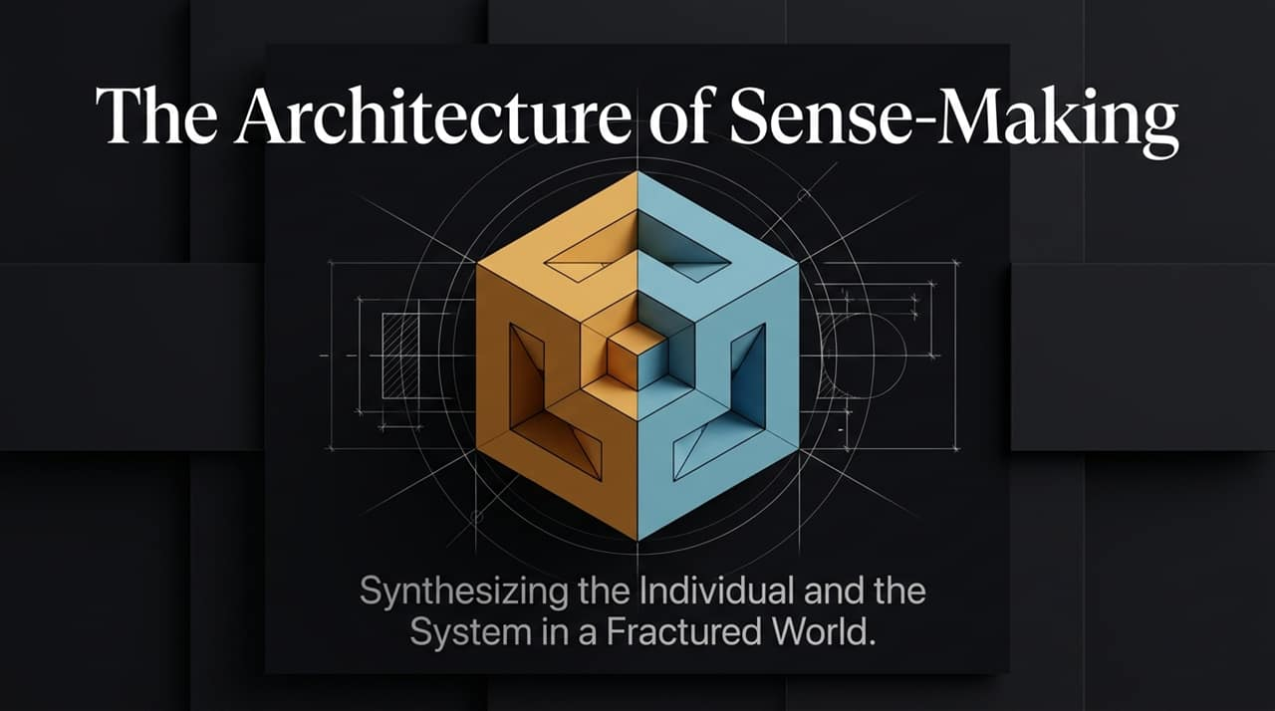
Notes:
Welcome, everyone. Today, we are exploring 'The Architecture of Sense-Making'—a framework for navigating discourse and truth in an era of collapsing institutions and extreme cultural polarization.
When we examine modern public discourse, we see a fractured landscape. On one side, institutions and economic structures are failing or turning pathological. On the other side, individuals feel atomized, anxious, and helpless.
In this presentation, we will synthesize two seemingly contradictory perspectives: the necessity of radical personal responsibility and the undeniable reality of broken macroeconomic systems. By combining rigorous individual virtue with sharp systemic critique, we can construct an elegant debate framework to make sense of our world.
https://www.youtube.com/watch?v=OQnyhTsmH5w

Slide 2
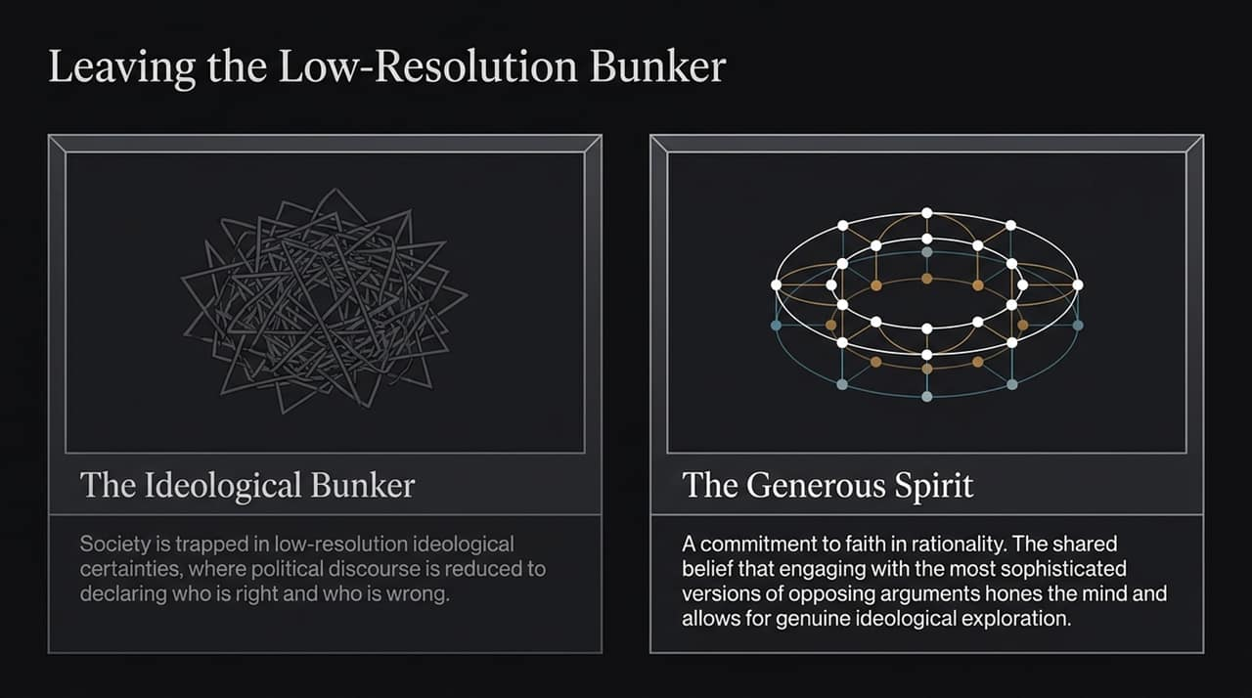
Notes:
Most modern political debate takes place in what we call the 'Low-Resolution Bunker'. In this space, discourse is reduced to declaring who is right and who is wrong, often flattening complex issues into tribal soundbites. As Ben Shapiro and Jordan Peterson note, people hunker down in their political bunkers where everything revolves around rigid low-resolution certainties
To leave this bunker, we need what Eric Weinstein calls a 'Generous Spirit'—a fundamental faith in rationality. This means operating under the assumption that if reasoning is done correctly, engaging with ideas won't lead to chaos
Furthermore, as Ben Shapiro highlights, productive discourse requires seeking out the most sophisticated version of an opponent's argument—'steel-manning' it rather than knocking down the weakest, caricatured version on social media. Engaging with superior arguments hones the mind and expands our worldview.

Slide 3
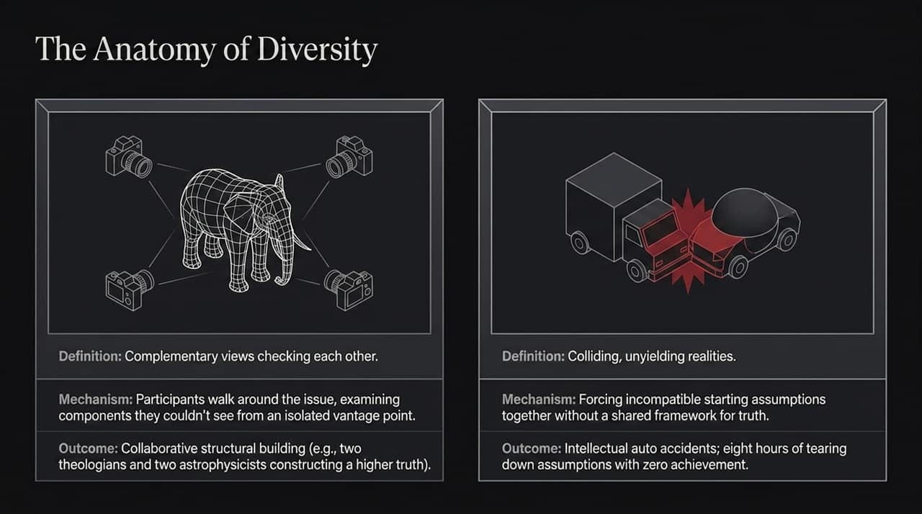
Notes:
We hear the word 'diversity' constantly, but Eric Weinstein makes a crucial distinction between 'Good Diversity' and 'Bad Diversity'.
Good Diversity occurs when individuals with different vantage points walk around a complex problem together. They check each other’s blind spots and build a higher structural truth. For example, when two theologians and two astrophysicists discuss deep questions within a shared commitment to truth, they construct a higher framework.
Bad Diversity, on the other hand, is like putting drivers who drive on the left side of the road with drivers who drive on the right side on the same highway without a shared rulebook. When participants clash on incompatible starting assumptions without a shared framework for truth, you get eight hours of tearing each other down—an intellectual auto accident with zero achievement

Slide 4
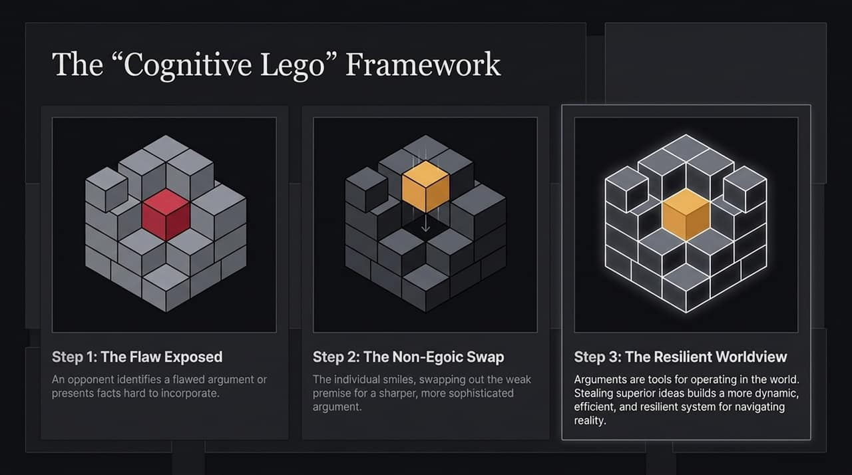
Notes:
How do we internalize new ideas without letting our egos get in the way? We use the 'Cognitive Lego' framework.
Step 1: An opponent identifies a flaw in your argument or presents unassailable facts that don't fit your model.
Step 2: Instead of getting angry or defensive, you smile. You perform a non-egoic swap, immediately trading out the weak premise for a sharper, more sophisticated idea.
Step 3: As Jordan Peterson explains, arguments are not abstract trophies; they are operational tools in your cognitive toolbox. Stealing superior ideas from your opponents sharpens your toolkit, allowing you to operate far more effectively and resiliently in the world.

Slide 5
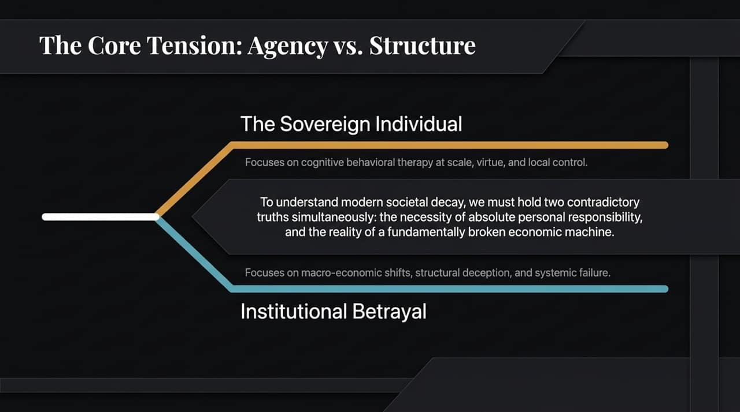
Notes:
Here we arrive at the primary tension of modern discourse: Individual Agency vs. Systemic Structure.
On one hand, thinkers like Ben Shapiro and Jordan Peterson champion the 'Sovereign Individual'. They emphasize cognitive behavioral therapy at scale, personal virtue, local control, and solving your own problems.
On the other hand, thinkers like Eric Weinstein point to 'Institutional Betrayal'—macroeconomic shifts, structural deception, and systemic failures that individuals cannot simply 'bootstrap' their way out of.
To properly diagnose societal decay, we must hold two contradictory truths at once: absolute personal responsibility is necessary, but broken economic machines are a stark reality.

Slide 6
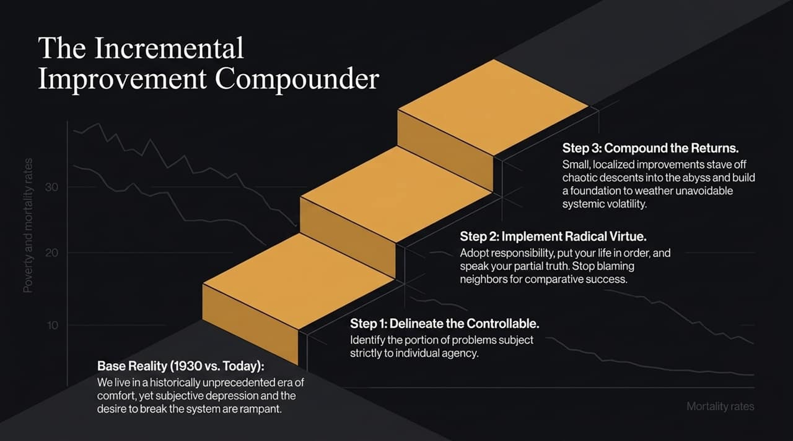
Notes:
Look at base reality: compared to 1930, we live in an era of unprecedented physical luxury, yet subjective depression, anxiety, and the urge to burn down the system are rampant.
How do we fix this? Through incremental compounding:
Delineate the Controllable: Identify the exact portion of your problems that falls strictly within your personal agency.
Implement Radical Virtue: Put your own life in order, clean your room, take on responsibility, and speak your partial truth. Stop getting bitter over a neighbor's comparative success.
Compound Returns: Small, localized improvements stave off chaotic descents into the abyss and create a solid buffer against unavoidable macroeconomic volatility.

Slide 7
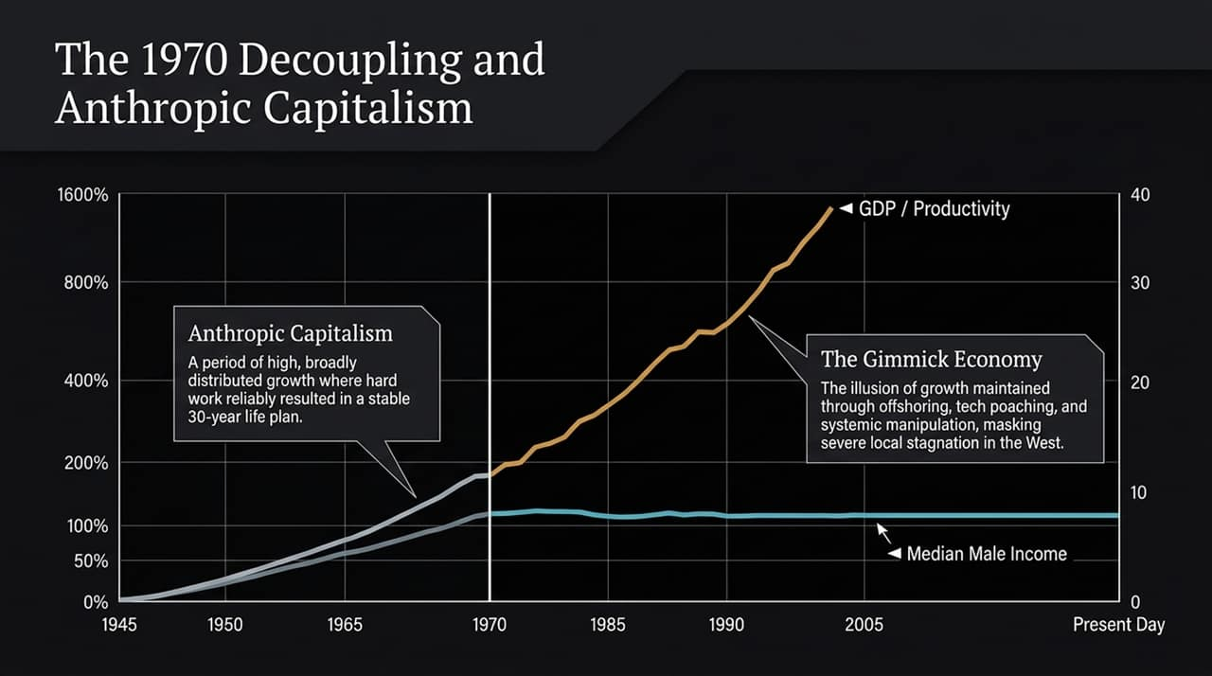
Notes:
To understand why people are angry, we must look at economic structure.
From 1945 to 1970, the West enjoyed 'Anthropic Capitalism'—a period where GDP growth and median male income tracked together. Hard work reliably yielded a low-variance, stable 30-year life plan.
Around 1970, a major phase change occurred: GDP/productivity continued to climb, while median wages flatlined. Since then, growth has often been masked by the 'Gimmick Economy'—offshoring, tech poaching, financial engineering, and market manipulation that disguise local stagnation in the West

Slide 8
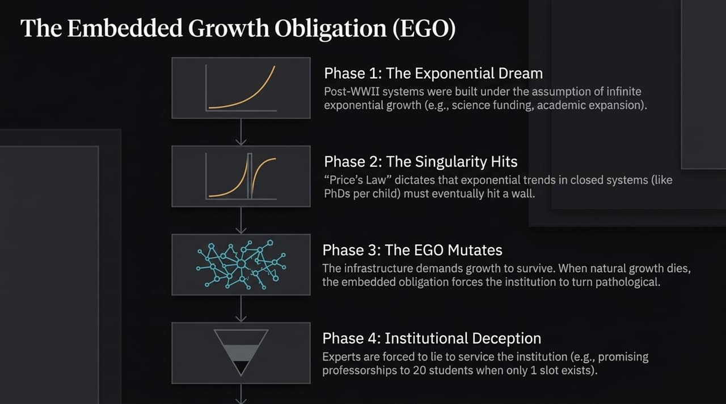
Notes:
Why do institutions lie to us? Eric Weinstein explains this via the 'Embedded Growth Obligation' (EGO).
Phase 1 & 2: Post-WWII institutions were designed assuming infinite exponential growth. But Price's Law dictates that exponential trends in closed systems eventually hit a wall—you cannot have exponentially more PhDs per child.
Phase 3 & 4: When natural growth stopped after 1970, institutional infrastructure still demanded growth to survive. The institution turned pathological. Experts were forced to lie and create hidden pyramid schemes—such as promising professorships to 20 PhD students when only one slot exists—just to keep institutions afloat.

Slide 9
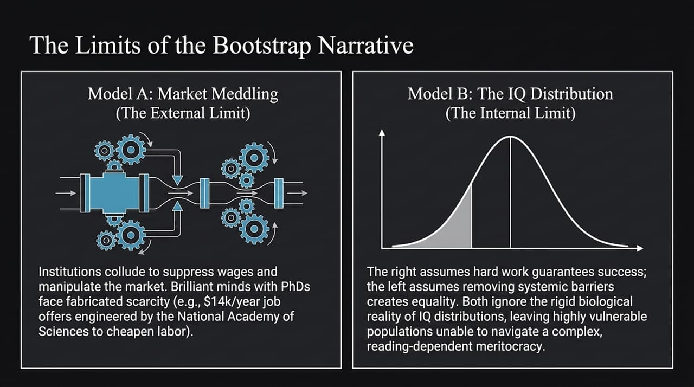
Notes:
While personal responsibility is vital, relying solely on a 'bootstrap narrative' ignores key realities:
Model A (Market Meddling): Institutions actively collude to suppress wages. Weinstein cites how the National Academy of Sciences artificially suppressed elite STEM wages in the 1990s, leaving brilliant PhD grads with $14k/year offers. Individual hard work cannot easily overcome systemic cartels.
Model B (IQ Distribution): Jordan Peterson points out that cognitive ability follows a distribution. In a complex, highly cognitive meritocracy, roughly 15–20% of the population has an IQ below 90. Both the right (assuming hard work solves all) and the left (assuming removing barriers creates equality) ignore these biological realities.

Slide 10
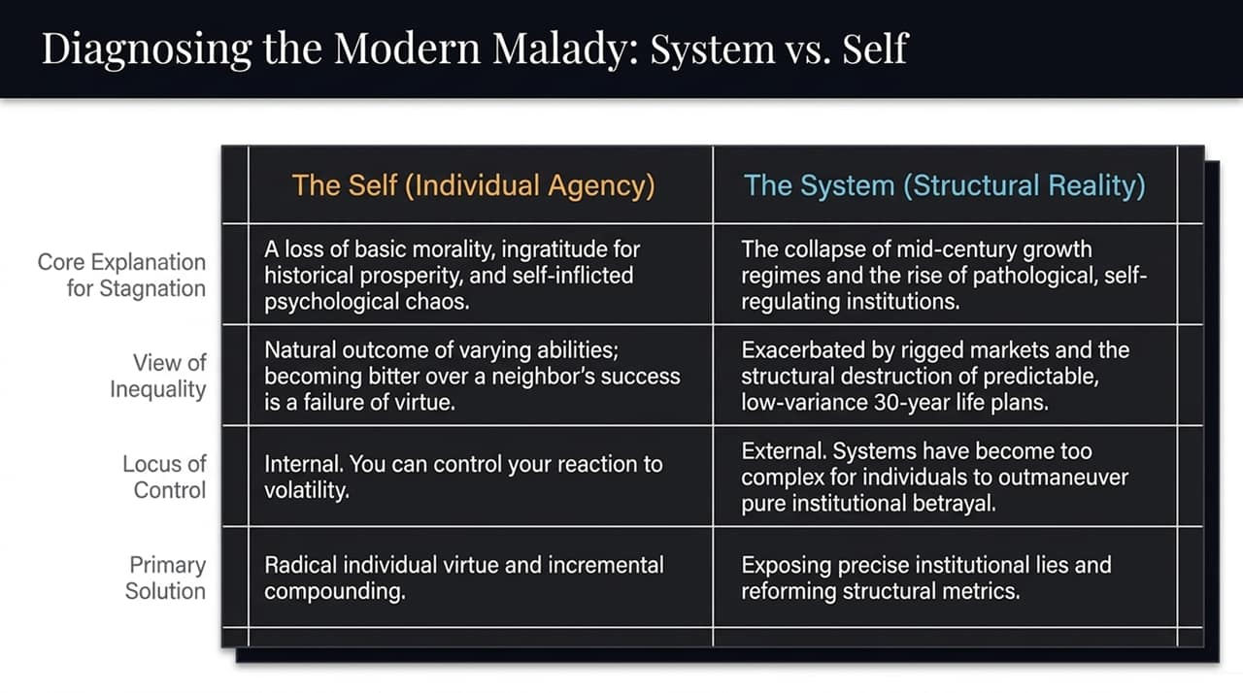
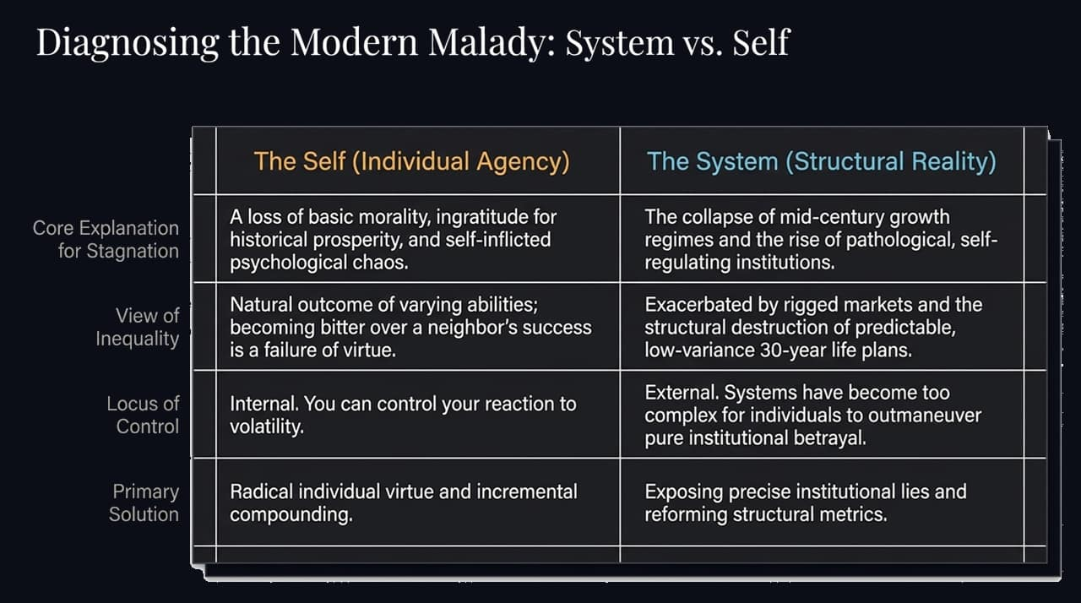
Notes:
This table synthesizes our diagnosis of the modern condition:
Stagnation: Is it caused by a loss of individual morality and chaotic self-inflicted choices? Or by the collapse of mid-century growth regimes?
Inequality: Is it the natural variance of human ability? Or the outcome of rigged markets and lost 30-year life plans,?
Locus of Control: Self advocates maintain an internal focus—you control your reaction to volatility,. System advocates note an external reality—some institutions are too pathological to outmaneuver alone.
Understanding both sides allows us to bridge political divides effectively.

Slide 11
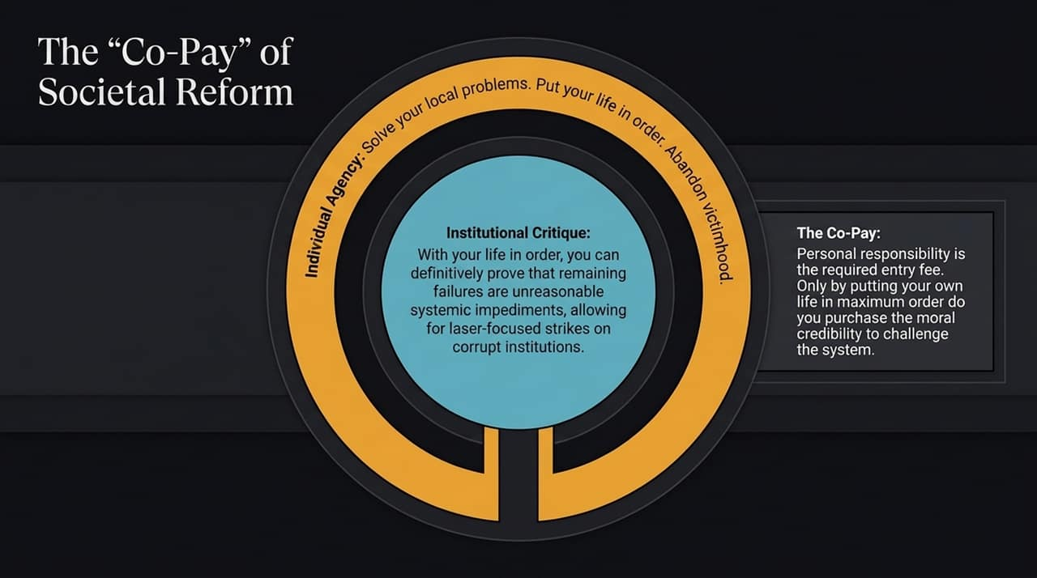
Notes:
How do we link the Individual and the System? Through the concept of the Co-Pay,.
Personal responsibility is your required entry fee for societal critique. You must pay the 'co-pay' of putting your local life in maximum order first.
Once your life is ordered, two things happen:
You eliminate self-inflicted chaos.
Any remaining failures can be definitively attributed to unreasonable systemic impediments. This gives you the moral authority and precision needed to challenge corrupt institutions.

Slide 12
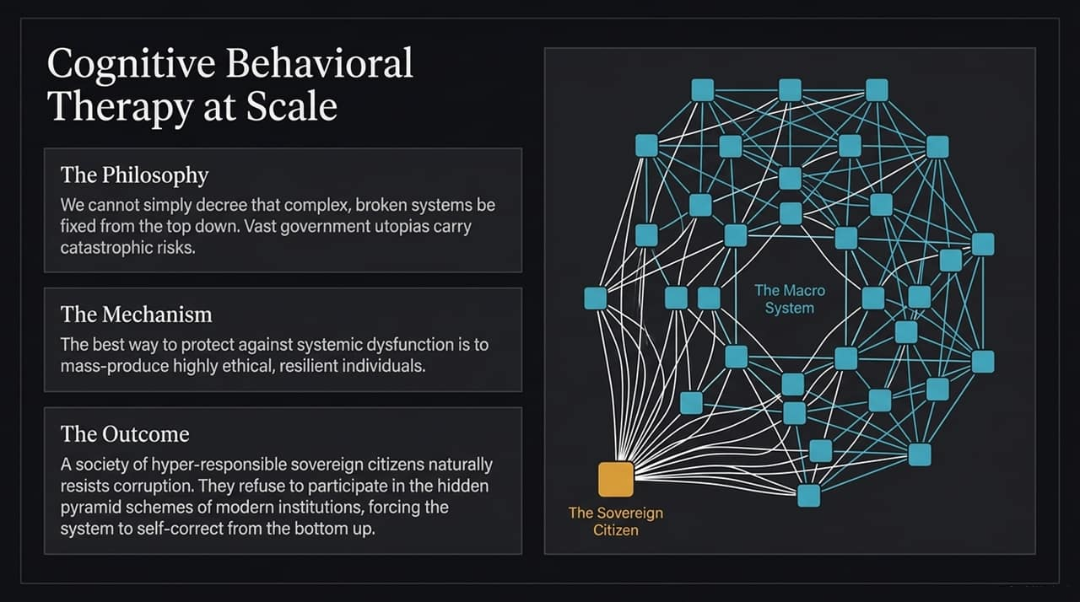
Notes:
Top-down government utopias carry immense catastrophic risks,. Real reform happens through Cognitive Behavioral Therapy (CBT) at scale.
By encouraging individuals to reject victimhood and take control of their thoughts and actions, we mass-produce ethical, resilient 'Sovereign Citizens',.
When citizens become hyper-responsible, they refuse to participate in institutional deceptions or hidden pyramid schemes. This forces complex institutions to self-correct from the bottom up.

Slide 13
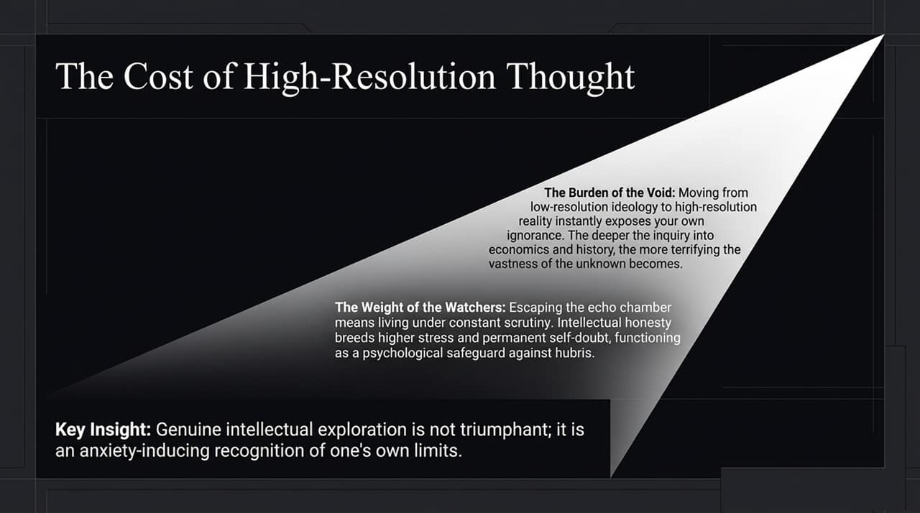
Notes:
Moving from low-resolution slogans to high-resolution truth comes at a high psychological cost:
The Burden of the Void: As Jordan Peterson notes, stepping out of ideological comfort exposes the vastness of what you do not know in economics, history, and science. Real inquiry is terrifying.
The Weight of the Watchers: Ben Shapiro emphasizes that public intellectual honesty brings intense scrutiny and stress. You live with constant self-doubt, double-checking your premises.
True intellectual exploration is not a victory lap; it is an anxiety-inducing recognition of human limitations

Slide 14
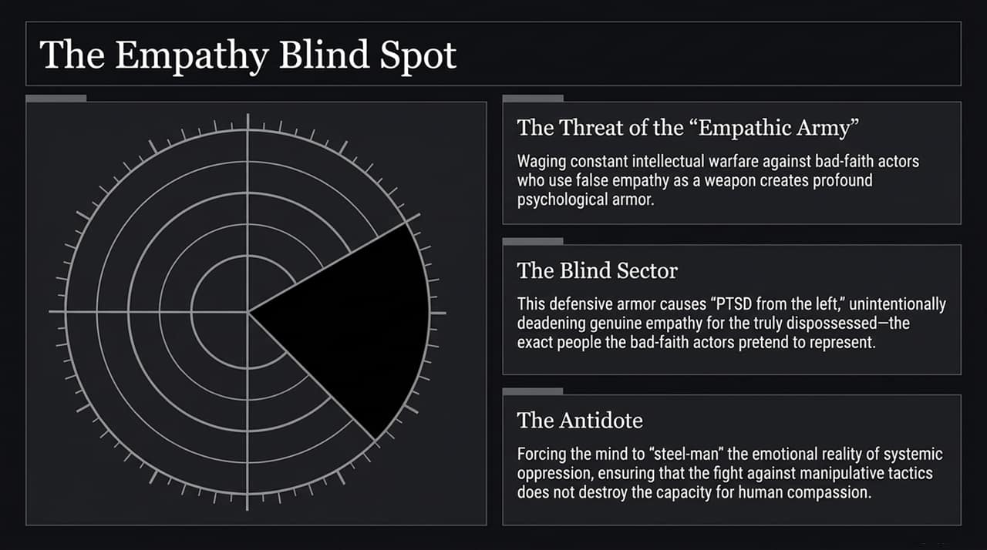
Notes:
A major trap for intellectual combatants is the Empathy Blind Spot.
When you constantly fight bad-faith actors who use weaponized empathy to stifle debate, you develop defensive psychological armor. Dave Rubin and Eric Weinstein call this 'PTSD from the left'.
The danger is that this armor deadens your genuine empathy for the truly dispossessed—the exact people bad actors claim to represent.
The antidote is to deliberately 'steel-man' the emotional and economic realities of systemic oppression, ensuring your battle against manipulative tactics does not destroy your capacity for human compassion

Slide 15
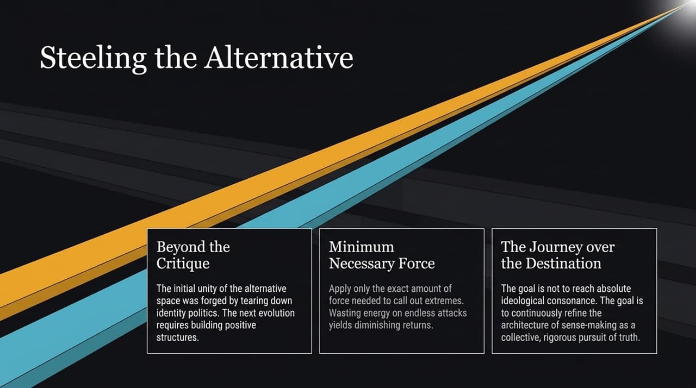
Notes:
Initial unity in alternative intellectual spaces was forged by tearing down bad ideas. But critique alone is insufficient; we must build positive alternatives.
Minimum Necessary Force: Jordan Peterson advises applying only the exact amount of force needed to call out ideological extremes. Wasting energy on constant attacks yields diminishing returns and turns discourse into caricature.
Journey over Destination: The ultimate goal is not total ideological consensus. It is enjoying and refining the collective journey of reason

Slide 16
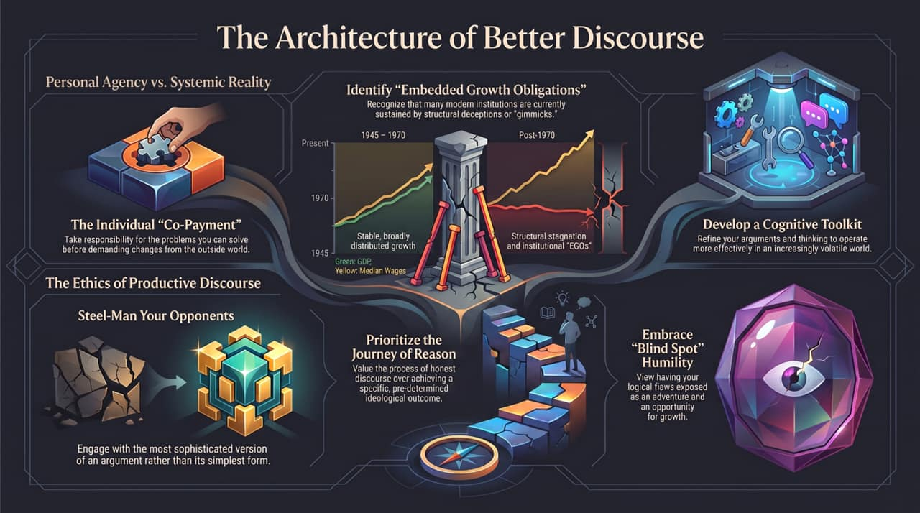
Notes:
To conclude, this diagram summarizes our master blueprint for sense-making:
1. Personal Agency vs. Systemic Reality:
Identify Embedded Growth Obligations and institutional deceptions.
Pay your individual 'co-payment' of personal virtue before demanding structural reform.
2. The Ethics of Productive Discourse:
Steel-man your opponent's position.
Build a dynamic cognitive toolkit.
Prioritize the journey of reason over dogmatic outcomes.
Embrace blind-spot humility, viewing exposed logical flaws as opportunities for growth.
Thank you.

